Slide 1
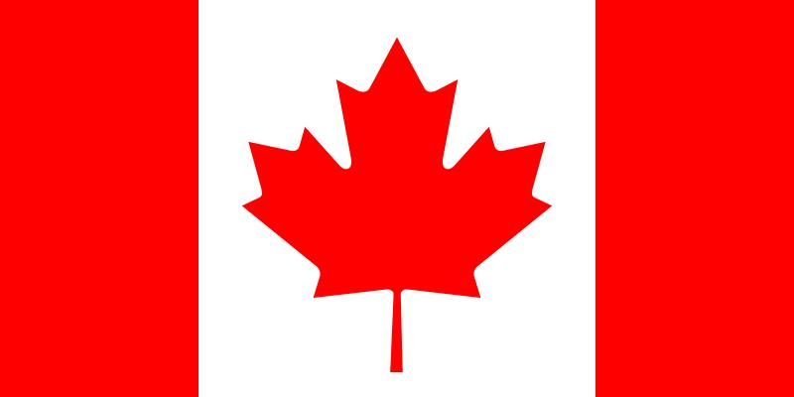
Canada’s Government

Slide 2

LESSON OPENING!!

Slide 3
LESSON OPENING
LESSON OPENING INSTRUCTIONS:
  1. We will review the “Magic Pyramid.”
  2. We will complete a maintenance activity. Students will label a map of North and Central America.
  3. Read and analyze the GPS and LEQ for today’s lesson.
  4. ATS: Students will review a video about NAFTA.
  5. We will preview/ review key vocabulary terms relevant to Canada’s government.

Slide 4
Georgia
Performance Standards
Word Wall
Essential
Questions
Enduring
Understandings

Slide 5
Georgia Performance Standard
SS6CG3 The student will explain the structure of the national government of Canada.
  a. Describe the structure of the Canadian government as a constitutional monarchy, a parliamentary democracy, and a federation, distinguishing the role of the citizen in terms of voting and personal freedoms.

Slide 6
Essential Questions
1. Describe the structure of the Canadian federal government.
2. Compare and contrast the federal governments of the United States and Canada.

Slide 7
Key Terms
1. Constitutional Monarchy
2. Parliament
3. Prime Minister
4. Ottawa
5. Quebec
6. Separatists
7. Congress
8. President
9. Washington, D.C.
10. Stephen Harper
11. Barack Obama

Slide 8
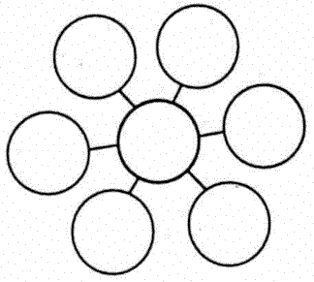
WORD SPLASH #1
CONSTITUTION
CONSTITUTION

Slide 9
WORD SPLASH #2
MONARCHY
MONARCHY

Slide 10
WORD SPLASH #3
CONSTITUTIONAL
MONARCHY

Slide 11
IT’S WORK SESSION TIME!!!!
LET’S WORK!!
LET’S WORK!!

Slide 12
WORK SESSION:
WORK SESSION INSTRUCTIONS:
1. We will review the GPS, Element, and Essential Questions.
2. We will look at the official web site of Canada’s government.
3. We will watch a video relevant to Canada’s government.
4. We will complete a series of reading passages that describe Canada’s government.
5. We will copy a graphic organizer that compares and contrasts the governments of the United States of America and Canada.
6. Complete review questions; Topic: Canada’s government.
(Students will use a variety of graphic organizers to take notes during the video, reading passages, and discussion)

Slide 13
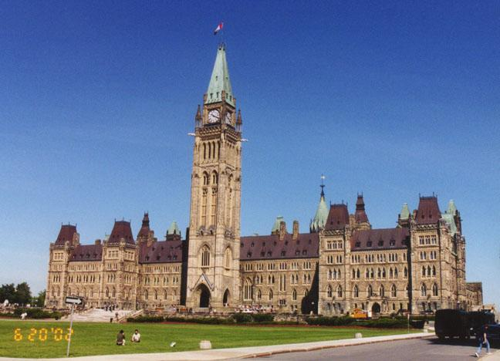
Canada’s Government

Slide 14
Georgia Performance Standard
SS6CG3 The student will explain the structure of the national government of Canada.
  a. Describe the structure of the Canadian government as a constitutional monarchy, a parliamentary democracy, and a federation, distinguishing the role of the citizen in terms of voting and personal freedoms.

Slide 15
Essential Questions
1. Describe the structure of the Canadian federal government.
2. Compare and contrast the federal governments of the United States and Canada.

Slide 16
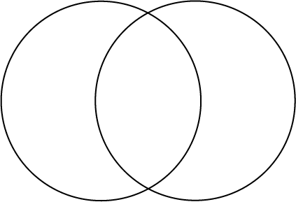
COMPARE AND CONTRAST
GOVERNMENT OF THE USA
GOVERNMENT OF CANADA

Slide 17
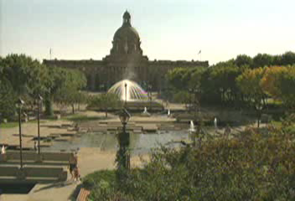
Structure of Canada’s Government Video

Slide 18


Comparing the Canadian and U.S. Governments
Aspects of Government | Canada | United States
TYPE | Constitutional Monarchy (limited power) | Constitutional Republic (limited power)
HEAD OF STATE | Monarch (Queen of England) *Governor-General | President
HEAD OF GOVERNMENT | Prime Minister | President
LEGISLATURE | Parliament | Congress
SYSTEM | Federal (central and provinces) | Federal (central and states)
CURRENT PRIME MINISTER/ PRESIDENT | Stephen Harper | Barack Obama
CAPITAL CITY | Ottawa, Ontario | Washington, D.C.
NUMBER OF PROVINCES/ STATES | 10 | 50
EXECUTIVE OF PROVINCES / STATES | Premier | Governor

Slide 19
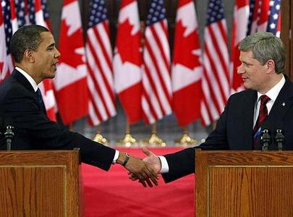
OBAMA AND HARPER

Slide 20
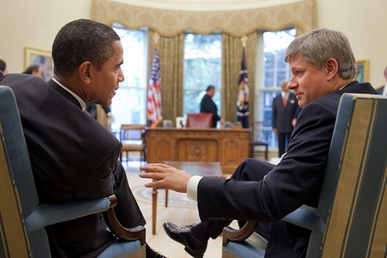
OBAMA AND HARPER IN THE OVAL OFFICE

Slide 21
STRUCTURE OF THE CANADIAN GOVERNMENT
  The Government of Canada is a constitutional monarchy. The monarch (king or queen) of the United Kingdom is the head of state and traditional symbolic leader of the country. The king or queen has little real power. The constitution of Canada explains how the government is organized. The constitution also explains the rights of the citizens of Canada. The constitution includes limits on the power of the king or queen of the United Kingdom.

Slide 22
STRUCTURE OF THE CANADIAN GOVERNMENT
  Canada has a parliamentary democracy. In a parliamentary democracy, citizens elect members of parliament called MP’s, who in turn elect the prime minister. The prime minister is the chief executive of the country. He heads the military, enforces laws, and keeps the country running day to day. The prime minister also leads the parliament.
  Canada also has a federal government. Power is divided between the central government and ten provinces. Canada’s provinces can write their own laws and elect their own leaders. The governments of the provinces are organized much like the national government of Canada. Instead of choosing a prime minister, provincial parliaments choose a premier.

Slide 23
COMPARE AND CONTRAST
GOVERNMENT OF THE USA
GOVERNMENT OF CANADA

Slide 24
Comparing the Governments Mini-Assessment
1. What type of government does Canada have?
2. What type of government does the U.S. have?
3. Who is the head of state of Canada?
4. Who is the head of state of the U.S.?
5. Who is the head of Canada’s government?
6. Who is the head of the U.S. government?
7. What is the legislature of Canada called?
8. What is the legislature of the U.S. called?
9. Who is the current Prime Minister of Canada?
10. Who is the current President of the United States?

Slide 25
Comparing the Governments Mini-Assessment
11. A province in Canada, is similar to a _________ in the USA.
12. A premier in Canada, is similar to a __________ in the USA.
13. Who elects the members of Parliament in Canada?
14. Who elects the Prime Minister of Canada?
15. What type of government exists in Canada?
  A. communist
  B. parliamentary democracy
  C. presidential democracy
  D. monachy

Slide 26
Georgia Performance Standard
SS6CG3 The student will explain the structure of the national government of Canada.
  a. Describe the structure of the Canadian government as a constitutional monarchy, a parliamentary democracy, and a federation, distinguishing the role of the citizen in terms of voting and personal freedoms.

Slide 27
Essential Questions
1. Describe the structure of the Canadian federal government.
2. Compare and contrast the federal governments of the United States and Canada.

Slide 28
LESSON CLOSING!!
LESSON CLOSING!!

Slide 29
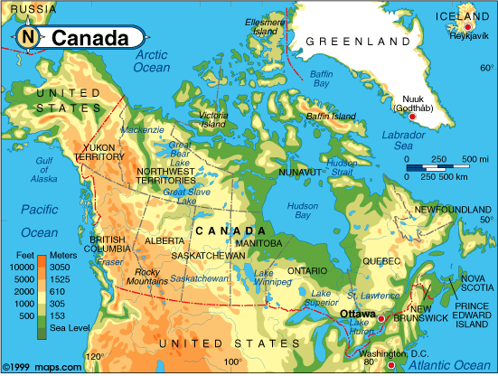
STUDENT CHALLENGE: Find selected locations in the element on the map of Canada!
  a. Locate on a world and regional political-physical map: the St. Lawrence River, Hudson Bay, Atlantic Ocean, Pacific Ocean, the Great Lakes, Canadian Shield, and Rocky Mountains.

