Slide 1
SS6G11 A
Diversity of European Languages

Slide 2
Comparison:
German, English, Russian, French, and Italian
Larger in landmass than U.S.
Doubled in population than U.S.
One dominant language in U.S.
Europe: home to more than two hundred native languages
3 main categories: Germanic, Romance, and Slavic

Slide 3
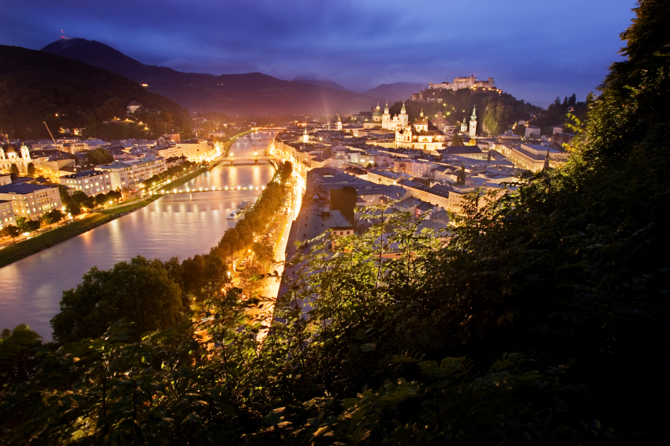
Germanic
Has the most native speakers
Live mostly in northwest and central Europe
20 percent of Europeans speak one or two languages: English and German as their native language.
Learn English as second language in schools even if not at home

Slide 4
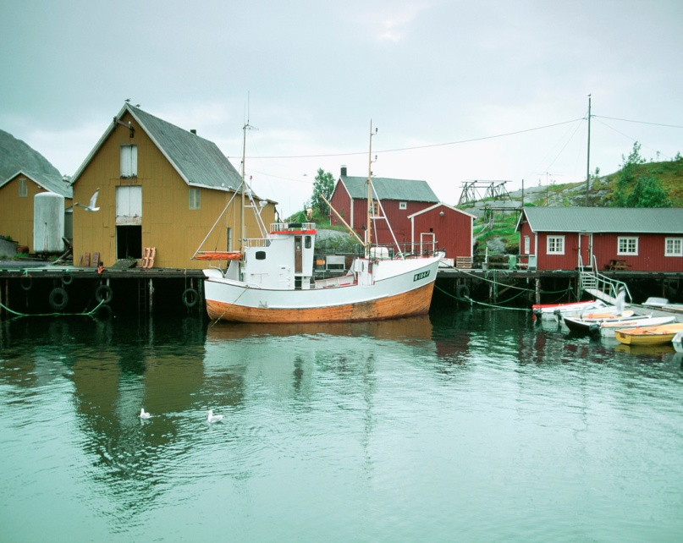
Romance
Includes French, Italian, and Spanish
Found in the south and west of Europe
Languages come from Latin, the language of the ancient Roman Empire
Roman alphabet used to write both Romance and Germanic languages

Slide 5
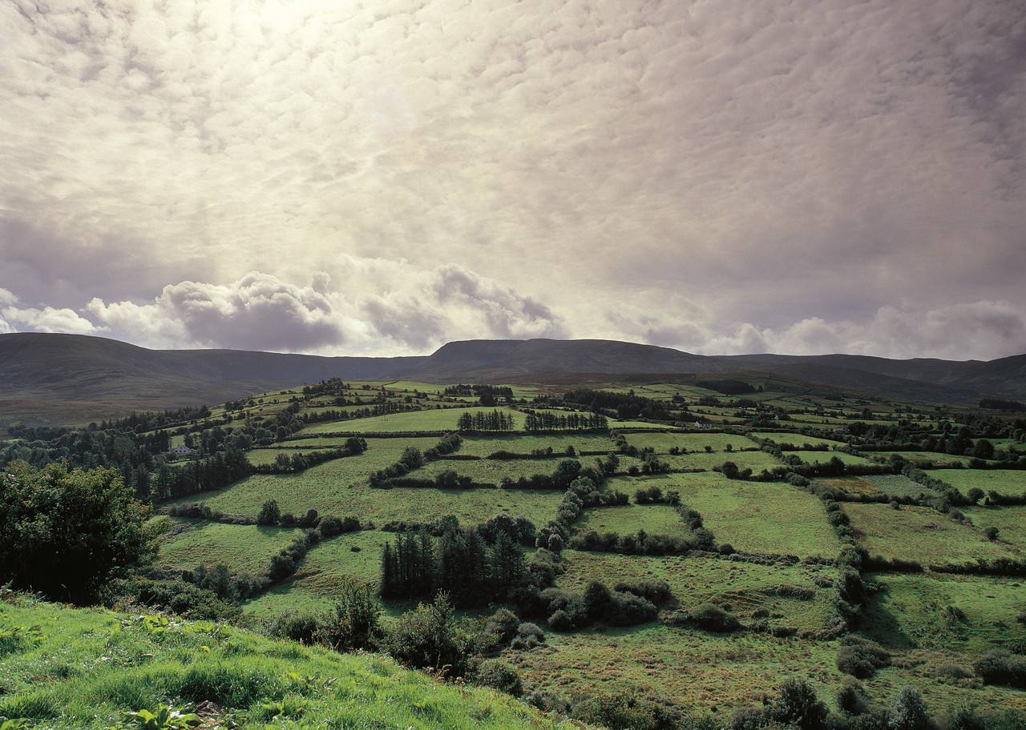
Slavic
Slavic language include Russia
Found in central and eastern Europe
Do not always use Roman alphabet
Instead written with Cyrillic alphabet

Slide 6
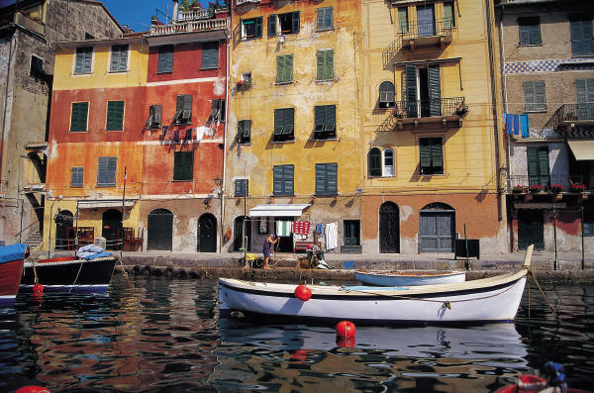
Having many languages can be challenging:
Difficult to live, work, and trade with people who cannot communicate with each other
Europeans have worked hard to solve this problem: school children learn one or two other languages beside their own
European Union has twenty three “official” languages :

Slide 7
The Literacy rate and standard of living
The ability to read and write
Usually found in develop or industrialized countries
Standard of living is high
Increase wealth of countries allows them to provide better education, healthcare, access to technology
DEVELOPING COUNTRIES or Third world countries:
Not much industry; depend on farming for most of wealth

Slide 8
Fewer people read and write
Education health care and jobs not easily available
may be restricted to allow boys
Lower paying jobs, countries are poor, people are uneducated
Difficult to pay for education when little money for food
Russia is different: high literacy rate; low GDP (total value of goods and services produced in a country in one year)
Always required education: poverty declining and Russia’s economy is growing

Slide 9
Literacy rate and per capita GDP
Country | Literacy Rate | GDP per person
United Kingdom | 99% | 35,100
France | 99% | 33,000
Russia | 99% | 14,700
Germany | 99% | 33,200
Italy | 98% | 30,400

