Slide 1
SS6H7 B and C
The student will explain conflict and change in Europe to the 21st century
Impact of WWII in terms of the Holocaust, origins of the Cold War, rise of Superpowers

Slide 2
Holocaust
Adolf Hitler: plan to conquer the world
Began systematic killing of every Jew- man, woman, or child-under Nazi rule
Imprisoned Jews, made to wear identifying armbands, separated from their families
Concentration camps: gas chambers
Thousands died from forced labor; little food, exposure to weather
Genocide: planned killing of race of people (6 million by the end of WWII

Slide 3
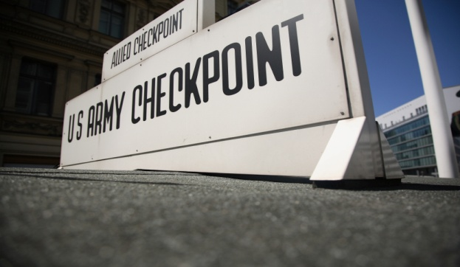
The Cold War
Beginning 1945, a period of distrust and misunderstanding between the Soviet Union and the U.S.
Soviets (communist) believe powerful central government should control the economy as well as the government
United States (democracy) believe business should be privately owned
Joseph Stalin Eastern Bloc
U.S. Western Bloc
Iron Curtain: line separating the two

Slide 4
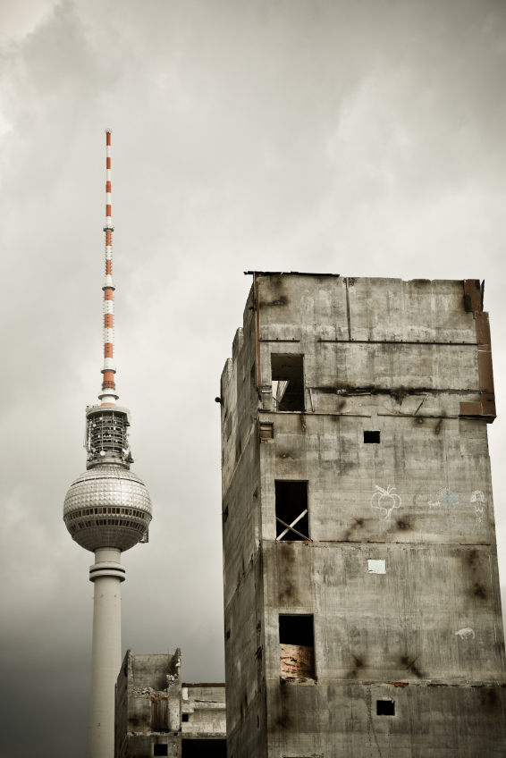
Cold War cont.
Division on Germany; four sections to keep it from regaining power
U.S., Great Britain, France, and Soviet Union
1948 Western Allies wanted to reunite Germany, Soviets did not
East/West Germany: capital Berlin divided
Communist leader built Berlin Wall
Each side thought the other was trying to rule the world; neither side gave up, people lived in fear of nuclear war, disaster for everyone on earth
Countries formed new alliances
NATO (North Atlantic Treaty Organization); Warsaw Pact

Slide 5
Rise of the Superpowers
U.S. and Soviet increased in influence
More countries allied with each
Both ability to influence world events and project world wide power
Evenly matched
World took sides

Slide 6
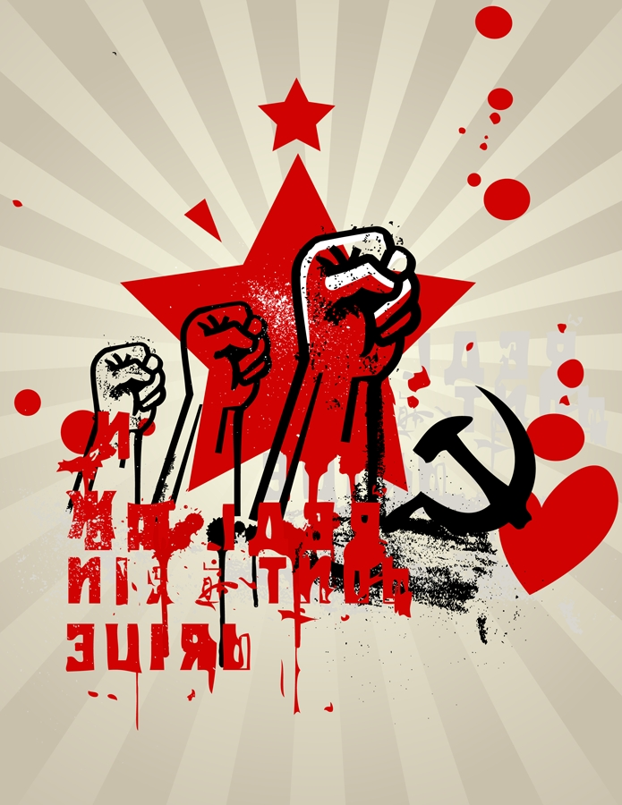
Soviets
Permanent seat on the UN Security Council
influence other communist countries and dictatorships around the world
third largest in world population
and second largest economy
military and space technology
world wide spy network (KGB)
one of the largest stockpiles of nuclear weapons in the world

Slide 7
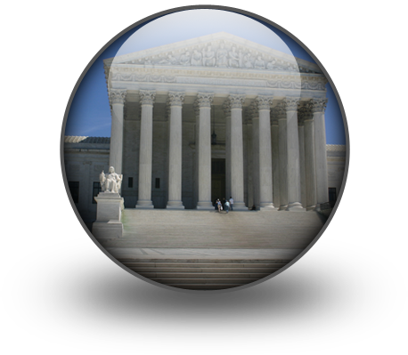
United States
Third largest country in the world
Permanent seat on the UN Security Council
Strong ties with Western Europe and Latin America
Fourth most populated country
Had powerful military support from NATO
Largest navy in the world
Bases all over the world; Warsaw Pact countries
Central Intelligence Agency (CIA)
Had a large reserve of nuclear weapons

Slide 8
Collapse of the Soviet Union
Spending more money putting down revolts within country and keeping up with the U.S. in the arms race
Economy was unstable
Mikhail Gorbachev: Reduce government control of business and increased freedoms for Soviet citizens
Helped improve relations with the U.S.

Slide 9
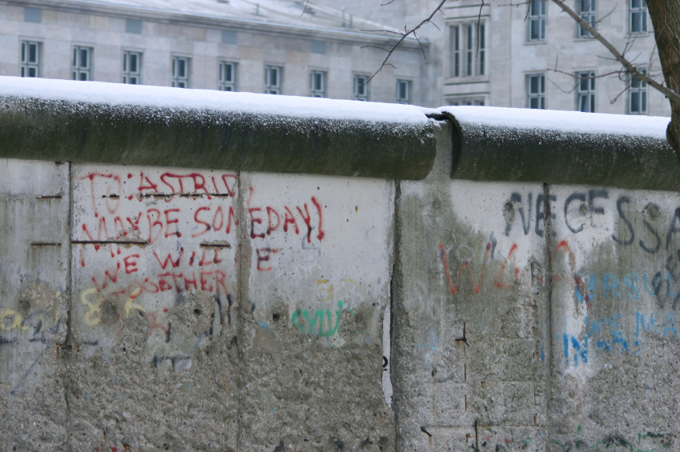
German Reunification
November 1989, Berlin Wall was torn down
Germany began unifying.
People around the world celebrated
East and West Germany made one country in 1990
Cold War was over
Soviet republics began seeking their independence
Soviet Union was no more
Many countries created
Russia was largest

